Slide 1

Data Analytics
tdc
the-data-condas
The Best Place to Work.

Slide 2

Where are the best opportunities for Data Analytics?
We want to help Bootcamp graduates understand the current US job market.
In order to set career paths.
To make informed decisions.
x
x

Slide 3

Hypothesis:
tdc
San Francisco is the best place to work for Data Analysts.

Slide 4
How do we define “Best”?
We want to help Bootcamp graduates understand the current US job market.
Highest pay.
Lowest cost of living.
Most open jobs relevant to our skills.
Most open jobs with great employee reviews.

Slide 5
Our Research
tdc
Sources
Name | Type | URL | Purpose
themuse.com job board | API | Row text | Row text
Glassdoor.com | csv | Row text | Row text
Cost of Living
Article top company | Row text | Row text | Row text
Article most desirable | 123.45 | 123.45 | 123.45

Slide 6
Collecting Data and Cleaning Data
tdc
x
API
.CSV
x
x
x
x
x
x

Slide 7

Data Analysis:

Slide 8
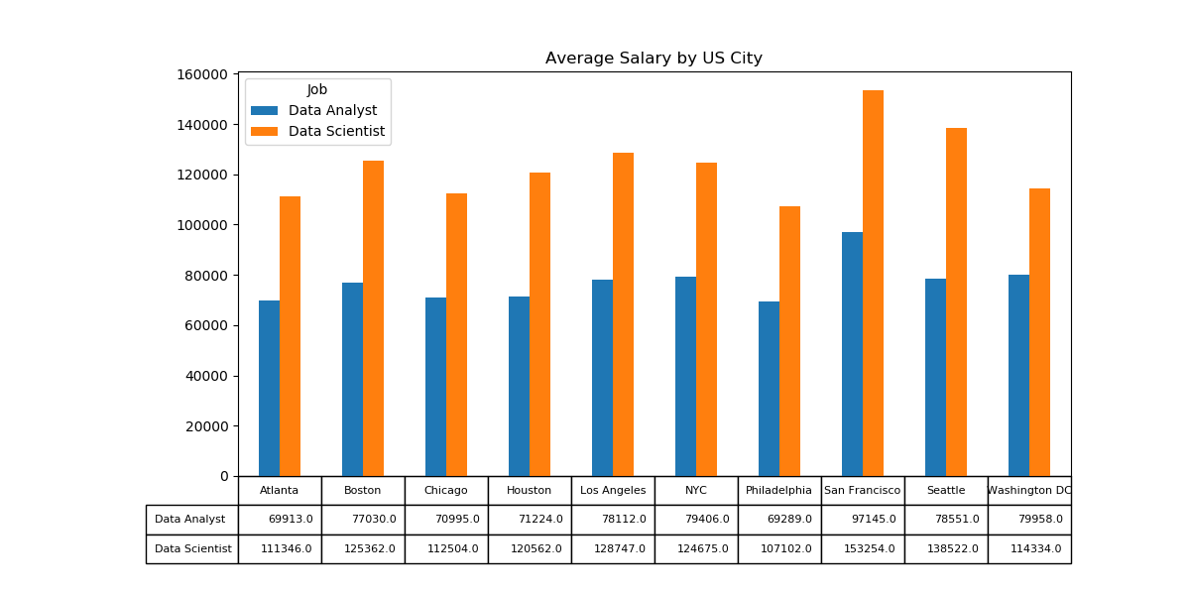
Which US city has highest salary?
tdc
Based on Average Salary for Top 10 US cities.

Slide 9
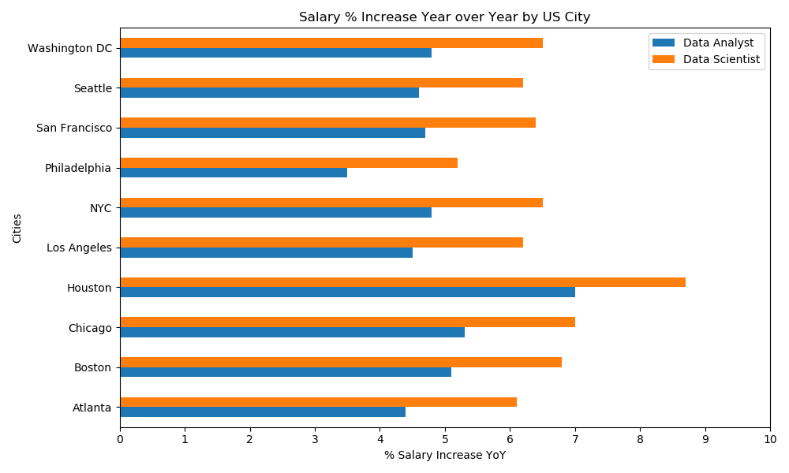
Which US city has highest salary increase over the last 12 months?
tdc
Based on Average Salary for Top 10 US cities.

Slide 10
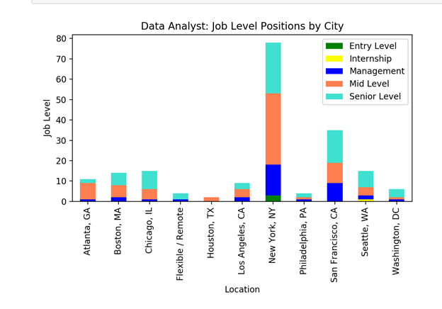
How many job openings does each city have for Data Analytics?
tdc
Sorted by entry, mid and senior levels.
findings

Slide 11
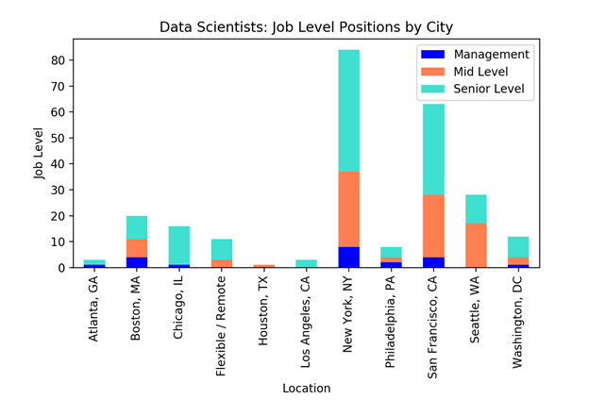
How many job openings does each city have for Data Science?
tdc
Sorted by entry, mid and senior levels.
findings

Slide 12
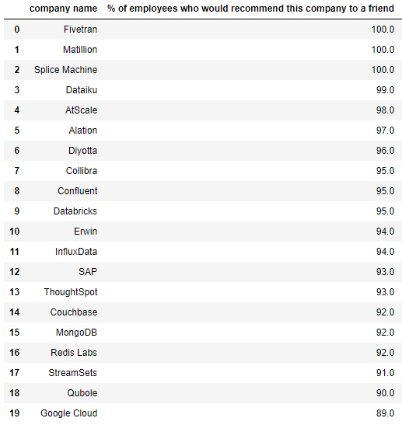
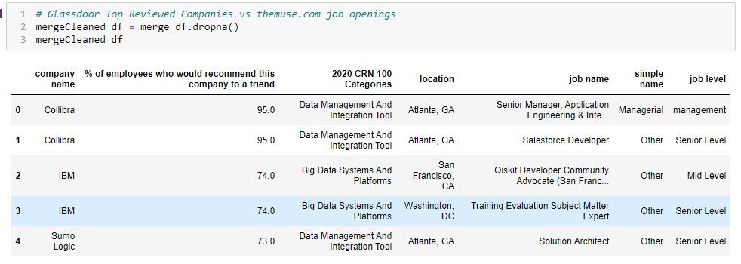
Glassdoor Best Big Data Companies to work for
tdc
based on Glassdoor.com survey as of 05/06/2020.
Top 20
Glassdoor Best Big Data Companies 2020 vs. themuse.com 06/20/2020
Collibra, Atlanta (2)
IBM, SF (2)
Sumo Logic, Atlanta (1)

Slide 13
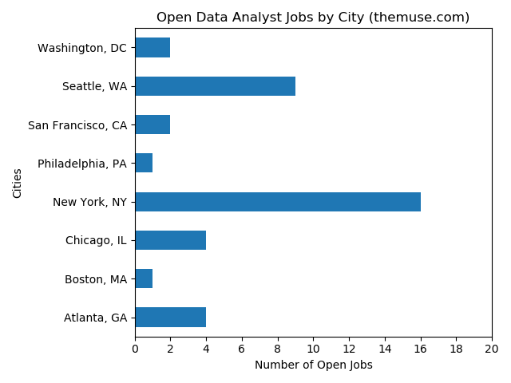
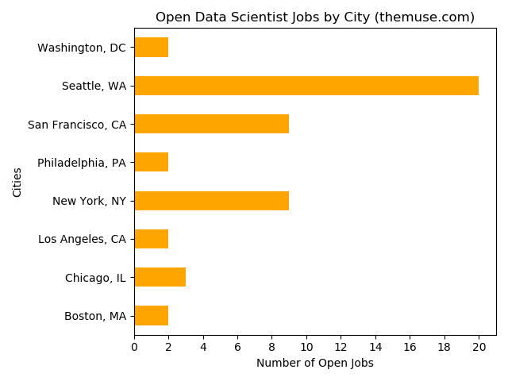
Job Openings for Fortune 500 Companies by Top 10 US Cities
tdc
Based on themuse.com 06/20/2020
Total Data Analyst: 39
No postings for Houston or LA
Total Data Scientist: 49
No postings for Houston or LA

Slide 14
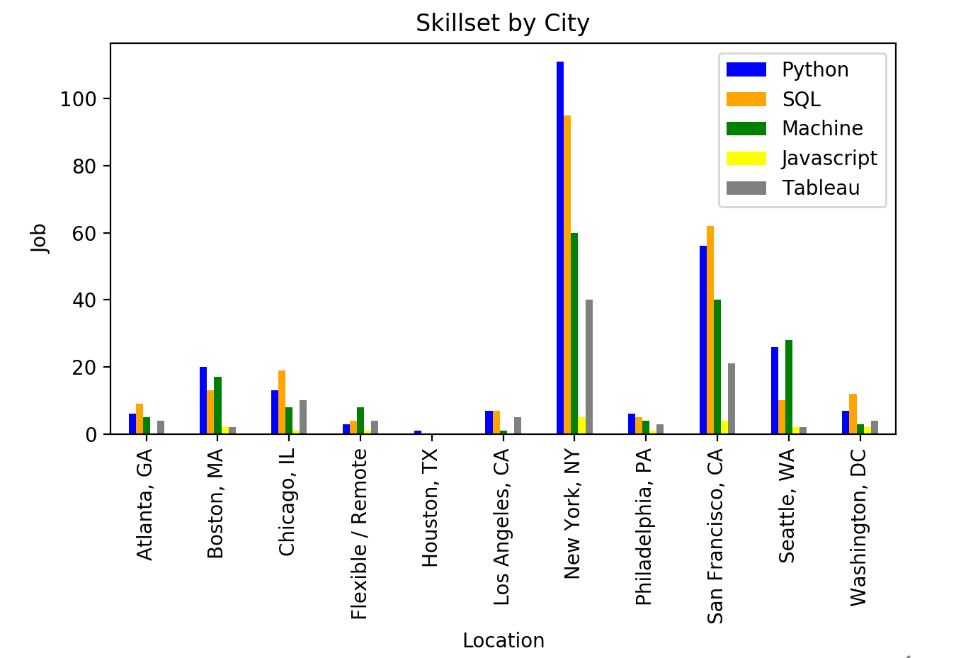
Skills
tdc
x
findings

Slide 15
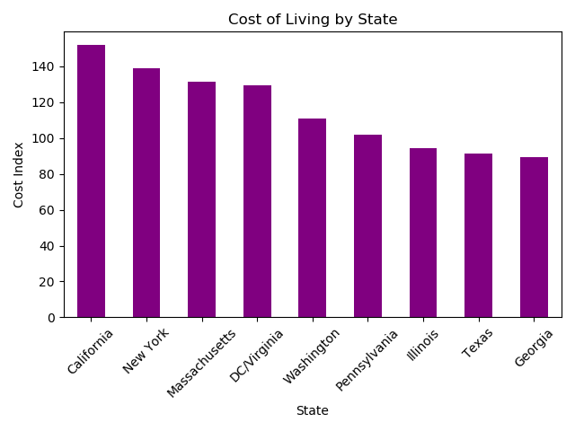
Which US city has the lowest cost of living?
tdc
States containing the Top 10 Cities.
findings

Slide 16
Challenges and Limitations
tdc
x
Up-to-date free API
.CSV
x
x
x
x
x
x

Slide 17
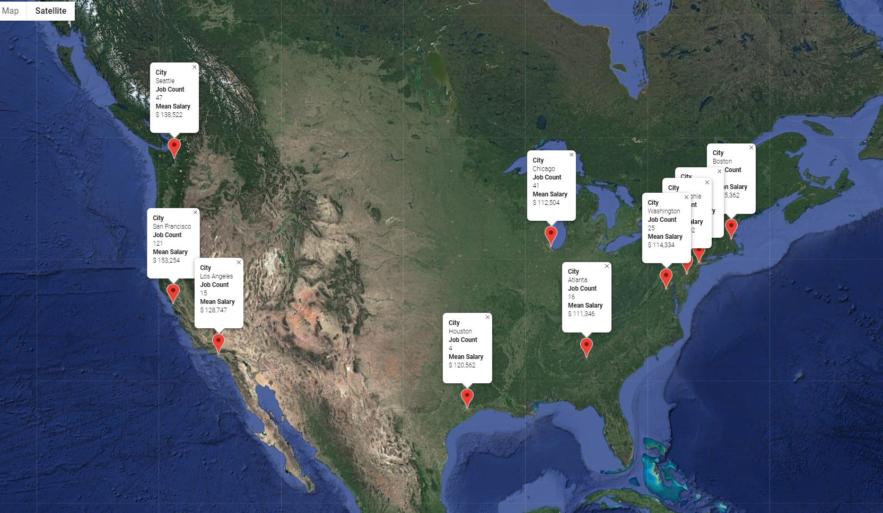
Conclusion
tdc
x
findings

Slide 18
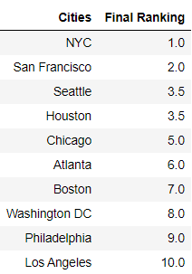
Conclusion DS
tdc
x
findings

Slide 19

Section Divider
tdc
the-data-condas
Subtitle

